Slide 1
IBM University Engagement Project Submission
“Exploring the Power of Agentic AI with IBM Granite and LangFlow”

Slide 2

Project Tile – Agentic AI for Personalized Course Pathways
Domain of Project – Education (EdTech) | Technology: IBM Cloud Lite & IBM Granite AI
Student Name | Recent Passport Photo | Email ID | Mobile number [WhatsApp]
Meda Sri Harshitha |  | sriharshithameda@gmail.com | 8977120320

Slide 3
Problem Statement -
Problem Statement: LearnMate – Agentic AI for Personalized Course Pathways
The Challenge
Students often struggle to choose the right courses and build a clear learning roadmap due to the overwhelming number of online resources and lack of personalized guidance.
The Objective
Build an AI-powered learning coach that provides:
✅ Personalized course recommendations
✅ Skill assessment and progress tracking
✅ Dynamic learning roadmaps based on goals and interests
✅ Career guidance and skill gap analysis
✅ Multi-agent system for recommendations, knowledge retrieval, and feedback
✅ Interactive dashboard to monitor learning progress and achievements

Slide 4
Proposed Solution -
AI-powered learning coach that provides personalized course recommendations and career guidance.
Uses RAG + IBM Granite Models to retrieve and summarize course information from trusted educational resources.
Multi-Agent System:
📚 Learning Knowledge Agent – Fetches course and skill information.
🎯 Course Recommendation Agent – Generates personalized learning paths.
🚀 Career Guidance Agent – Provides career suggestions and skill gap analysis.
📈 Progress Tracking Agent – Monitors progress and adapts recommendations.
Creates dynamic learning roadmaps based on interests, skills, and career goals.
Includes an interactive dashboard to visualize progress, completed courses, and skill development.
Built using IBM Cloud Lite, watsonx.ai, and Granite Models for scalable and intelligent personalized learning.
Outcome: An end-to-end AI mentor that guides students toward the right courses and career pathways.

Slide 5
Technology Used
🔹 LangFlow Platform – Designs and orchestrates the multi-agent workflow visually.
🔹 IBM Granite Model (ibm-granite-3-2-8b) – Powers natural language understanding, reasoning, and personalized course recommendations.
🔹 IBM Cloud – Provides secure, scalable infrastructure for building and deploying LearnMate.
🔹 RAG (Retrieval-Augmented Generation) – Retrieves real-time course information and generates accurate, personalized recommendations.
🔹 IBM watsonx.ai – Enables model deployment, embeddings, and AI governance.
🔹 Vector Database (FAISS/Chroma) – Stores course embeddings for efficient information retrieval.
🔹 FastAPI + Streamlit/React – Backend APIs and interactive dashboard for learning progress and recommendations.

Slide 6
Langflow component Used -
1) Chat Input: Interface where users enter their interests, career goals, skill levels, and learning preferences (text/voice).
2) IBM watsonx.ai Agent: Processes user inputs using IBM Granite models to generate personalized learning recommendations and career guidance.
3) IBM Granite Model: Granite-4.0-8B-Instruct → Fast and efficient for real-time course recommendations, roadmap generation, and reasoning.
4) Chat Output: Displays AI-generated responses such as personalized course pathways, skill gap analysis, and career recommendations.
5) File Component: Stores and retrieves user profiles, completed courses, learning progress, and educational datasets.
6) Vector Store (FAISS/Chroma):Stores course embeddings and educational content for RAG-based retrieval and personalized recommendations.

Slide 7
Langflow workflow -

Slide 8
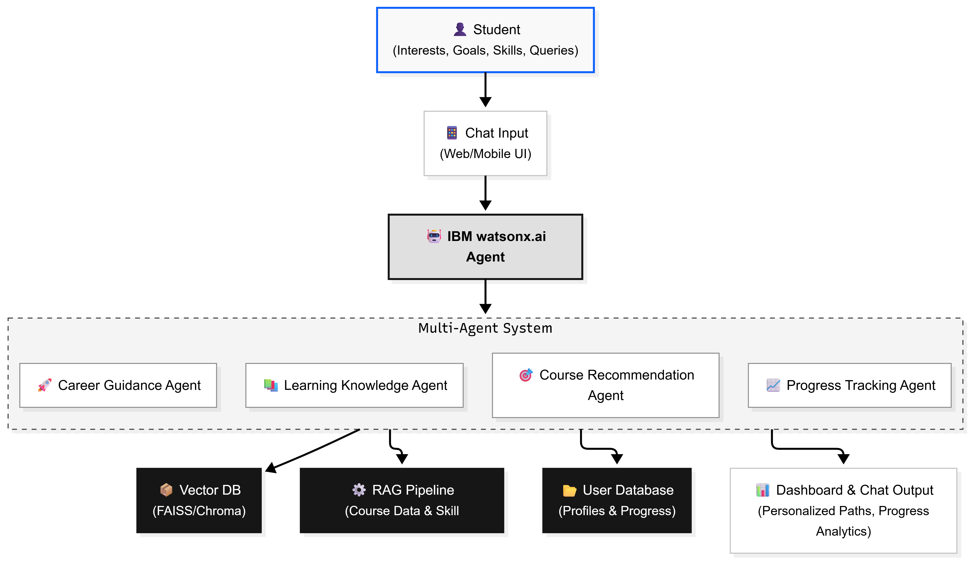
Architecture blueprint

Slide 9
Role of Agentic AI in the solution
🤖 Acts as an Intelligent Learning Coach by understanding students' interests, skills, and career goals.
🎯 Makes Autonomous Decisions to recommend the most relevant courses and learning pathways.
📚 Retrieves Knowledge Dynamically using RAG to fetch up-to-date course and skill information.
🔄 Adapts Continuously by updating recommendations based on user progress and changing preferences.
🚀 Provides Personalized Career Guidance through skill gap analysis and career-oriented roadmaps.
📈 Monitors Progress and Gives Feedback to keep students motivated and on track.
🔗 Coordinates Multiple Agents (Knowledge, Recommendation, Career Guidance, and Progress Tracking) to deliver an end-to-end personalized learning experience.

Slide 10
Token Usage
11,761 tokens are used
Before Prompt
Available Tokens: 25,038
After Prompt
Available Tokens: 13,277
Tokens Consumed: 11,761
Breakdown
Input Tokens: Student interests, skills, career goals, and queries.
RAG Context Tokens: Retrieved course information and educational content.
Output Tokens: Personalized learning pathways, recommendations, and feedback.
Formula:
Tokens Used = Before Prompt Tokens – After Prompt Tokens
= 25,038 – 13,277
= 11,761 Tokens

Slide 11
Novelty and Uniqueness
✨ Agentic AI Learning Coach – Goes beyond simple course recommendations by acting as a personalized AI mentor.
🧠 Multi-Agent Architecture – Separate agents for knowledge retrieval, recommendations, career guidance, and progress tracking.
📚 RAG-Powered Recommendations – Retrieves real-time course and skill information from trusted educational resources.
🎯 Dynamic Personalized Roadmaps – Continuously adapts learning paths based on progress, interests, and career goals.
📈 Skill Gap Analysis – Identifies missing skills and recommends targeted learning resources.
🚀 Career-Oriented Guidance – Aligns learning pathways with industry roles such as Data Science, Cybersecurity, and Frontend Development.
📊 Interactive Progress Dashboard – Visualizes course completion, skills acquired, and goal achievement.
Unique Value Proposition
"LearnMate is not just a course recommender—it is an adaptive AI mentor that continuously guides students toward the right skills, courses, and career paths."

Slide 12
Git Hub Link
https://github.com/Sriharshithameda/Agentic-AI-for-Personalized-Course-Pathways

Slide 13
Future Scope
🎓 Integration with MOOCs – Connect with platforms like Coursera, edX, Udemy, and NPTEL for real-time course recommendations.
🤖 AI Mentor & Doubt Assistant – Provide 24/7 personalized learning support and career guidance.
📄 Resume & Portfolio Builder – Generate ATS-friendly resumes and showcase completed projects.
💼 Internship & Job Recommendations – Match users with relevant internships and job opportunities based on acquired skills.
🏆 Certification & Skill Verification – Recommend industry-recognized certifications and track achievements.
🌍 Multilingual Support – Enable personalized learning in multiple languages for wider accessibility.
📊 Advanced Learning Analytics – Predict skill gaps, learning outcomes, and career readiness using AI.
·
·
·

Slide 14
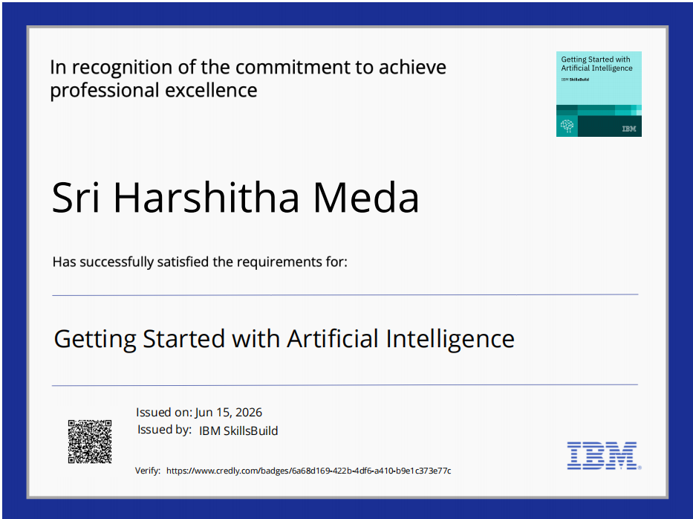
Certificates Earned:

Slide 15
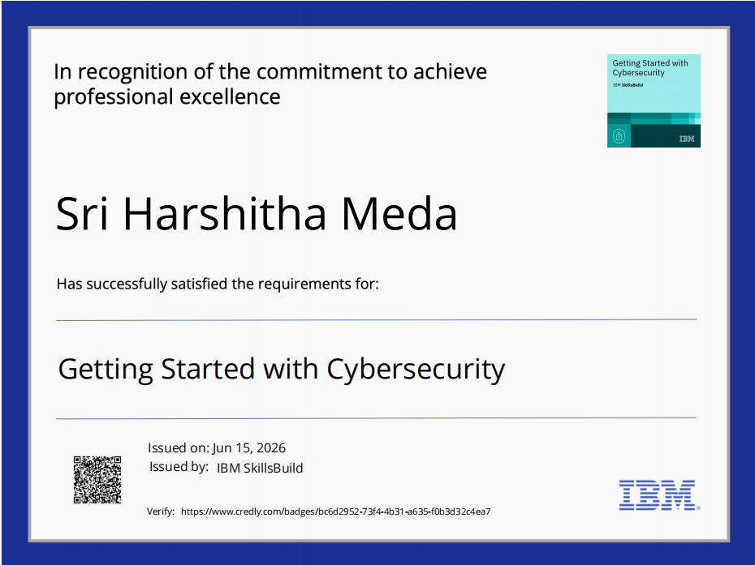
Certificates Earned:

Slide 16
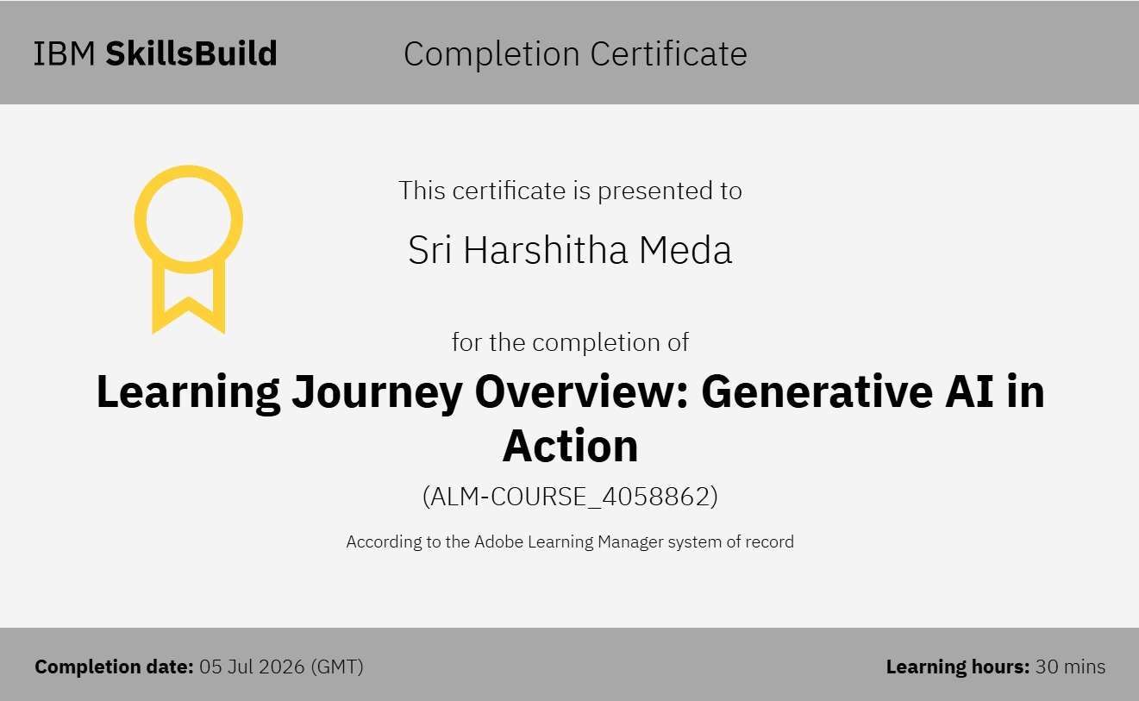
Certificates Earned:

Slide 17
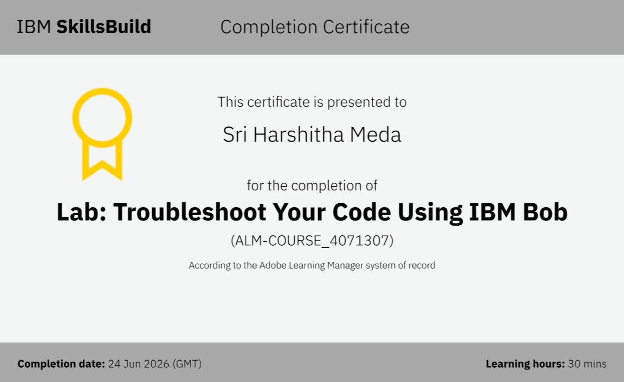
Certificates Earned:​

Slide 18
THANK YOU

